Slide 1
Arrays
Prof. Dhananjay S. Deshpande
SICSR, Pune - 16.

Slide 2
Implementation of ADT : Array
An implementation of ADT consists of storage structures to store the data items and algorithms for basic operation

Slide 3
ADTs
In this simple example, it does illustrate the concept of an Abstract Data Type
ADT consists of
The collection of data items
Basic operation that must be performed on them
In the example, a collection of data is a list of seats
The basic operations are (1) Scan the list to determine which seats are occupied (2) change seat’s status

Slide 4
Data Structure and Abstract Data Type
The term of Data Structure and Abstract Data Type are often used interchangeably
However, we use ADT when data is studied at a logical level
The term data structure refers to a construct in programming language that can be used to store data

Slide 5
Array ADT
Collection of data elements
  A fixed-size sequence of elements, all of the same type
  An array is a finite, ordered and collection of homogeneous data elements.
Basic Operations
  Direct access to each element in the array by specifying its position so that values can be retrieved from or stored in that position

Slide 6
Array: Terminology
Size
Type
Base
Index
Range of Index
Word

Slide 7
Different types of Array
One-dimensional array: only one index is used
Multi-dimensional array: array involving more than one index
Static array: the compiler determines how memory will be allocated for the array
Dynamic array: memory allocation takes place during execution

Slide 8
One-Dimensional Static Array
Syntax:
ElementType arrayName [CAPACITY];
ElementType arrayName [CAPACITY] =
{ initializer_list };
Example:
int b [10];
int b [10]={1,2,3,4,5,6,7,8,9,10};

Slide 9
Example of array
Consider array a,b,c,d to store collection of 10 integers declared by:
int capacity=10
int a[capacity],
b[capacity]={1,2,3,4,5,6,7,8,9,10},
c[capacity]={1,2,3},
d[capacity]={0};
char name[capacity]=“John Doe”;

Slide 10
Memory Allocation, Addressing Array
A[100] => 100 words memory allocated.
Address (A[i]) = M + (i-1)
where i- is index of element, M – first elements memory location.
If L is lower bound & U is Upper Bound of Array then
Address (A [i]) = M + (i-L) x w
(indexing Formula)

Slide 11
Operations on Array
Traversing
Sorting
Searching
Insertion
Deletion
Merging

Slide 12
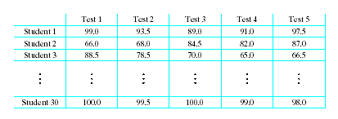
Multidimensional Arrays
Consider a table of test scores for several different students

Slide 13
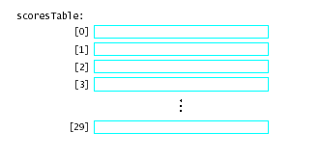
Array of Array Declarations
An array of arrays
  An array whose elements are other arrays

Slide 14
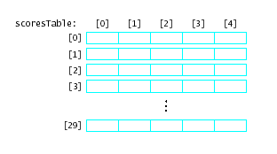
Array of Array Declarations
Each of the rows is itself a one dimensional array of values
scoresTable [1][3]
scoresTable[2]
is the whole row numbered 2

Slide 15
Multidimensional Arrays
Syntax:
ElementType arrayName [num_rows][num_columns];
int scoretable [num_students][num_tests];
int scoretable[2][5]={{80,80,80,80,80},{60,60,60,60,60}};
If you want to change the score of first student’s 3rd test score to 100, you just need to do:
Scoretable[0][2]=100

Slide 16
Multidimensional Arrays
Consider multiple pages of the student grade book
typedef double
ThreeDimArray[NUM_ROWS][NUM_COLS][NUM_RANKS];
. . .

